Slide 1
Team 3 Confirmed
Week 3

Slide 2
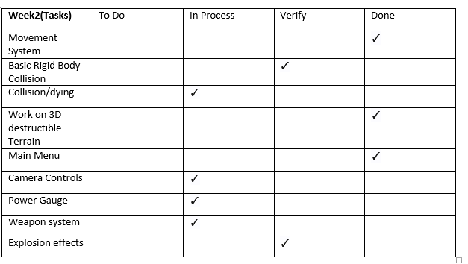
Sprint Backlog

Slide 3
Implementation
Terrain Done™
Terrain and Game Flow Integrated
Tank integration ongoing
Tank movement
Explosion effect

Slide 4
Issues Faced
Terrain
Slowness
Polynomial time
Collision
‘Gotchas’
Collision
Tank/Gun/Bullet

Slide 5
Planned For Next Week
Further Integration
Optimize Terrain
Game Flow
UX for weapon selection

Slide 6
Thanks for Listening Sorry for the Pink ☹

